Slide 1


PHISHING AWARENESS
AUGUST 2025
Phishing Awareness Training
HOW TO SPOT AND AVOID ONLINE SCAMS
Presented By. Arslan Ali

Slide 2
PHISHING AWARENESS
AUGUST 2025
Why You Should Care
It only takes one click to compromise an entire organization.
Phishing is the #1 attack used in cybercrime.
3.4 billion phishing emails are sent daily.
Over 90% of data breaches begin with phishing.
Even top companies like Google, Facebook, Twitter have been fooled.
Phishing is no longer just an IT issue — it’s a human risk

Slide 3
PHISHING AWARENESS
AUGUST 2025
What is Phishing?
Phishing is a deceptive attack where cybercriminals trick you into giving away sensitive information — like passwords, credit card numbers, or even your identity.
Goal:
Exploit trust and human error using fake emails, websites, or messages.
Phishing evolves. So should your awareness.

Slide 4








MANY FACES OF PHISHING
Email Phishing
Fake emails that look like they’re from companies you trust (like banks or social media).
Spear Phishing
Targeted emails that use your name or info to seem personal and real.
Smishing
Scam messages sent to your phone via SMS, often with bad links.
Vishing
Scam phone calls pretending to be from banks, tech support, or government.
Clone Phishing
A real email is copied, but with a dangerous link or file added inside.
Phishing keeps evolving. So must our awareness — and yours.

Slide 5

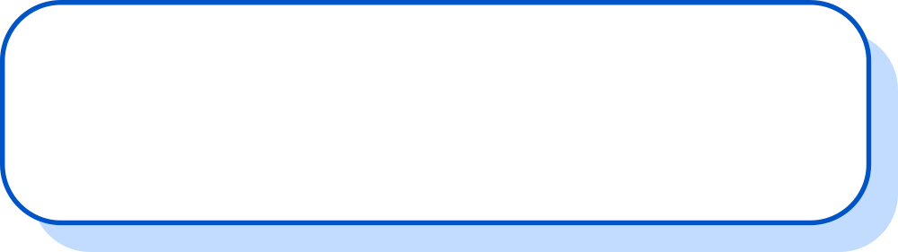
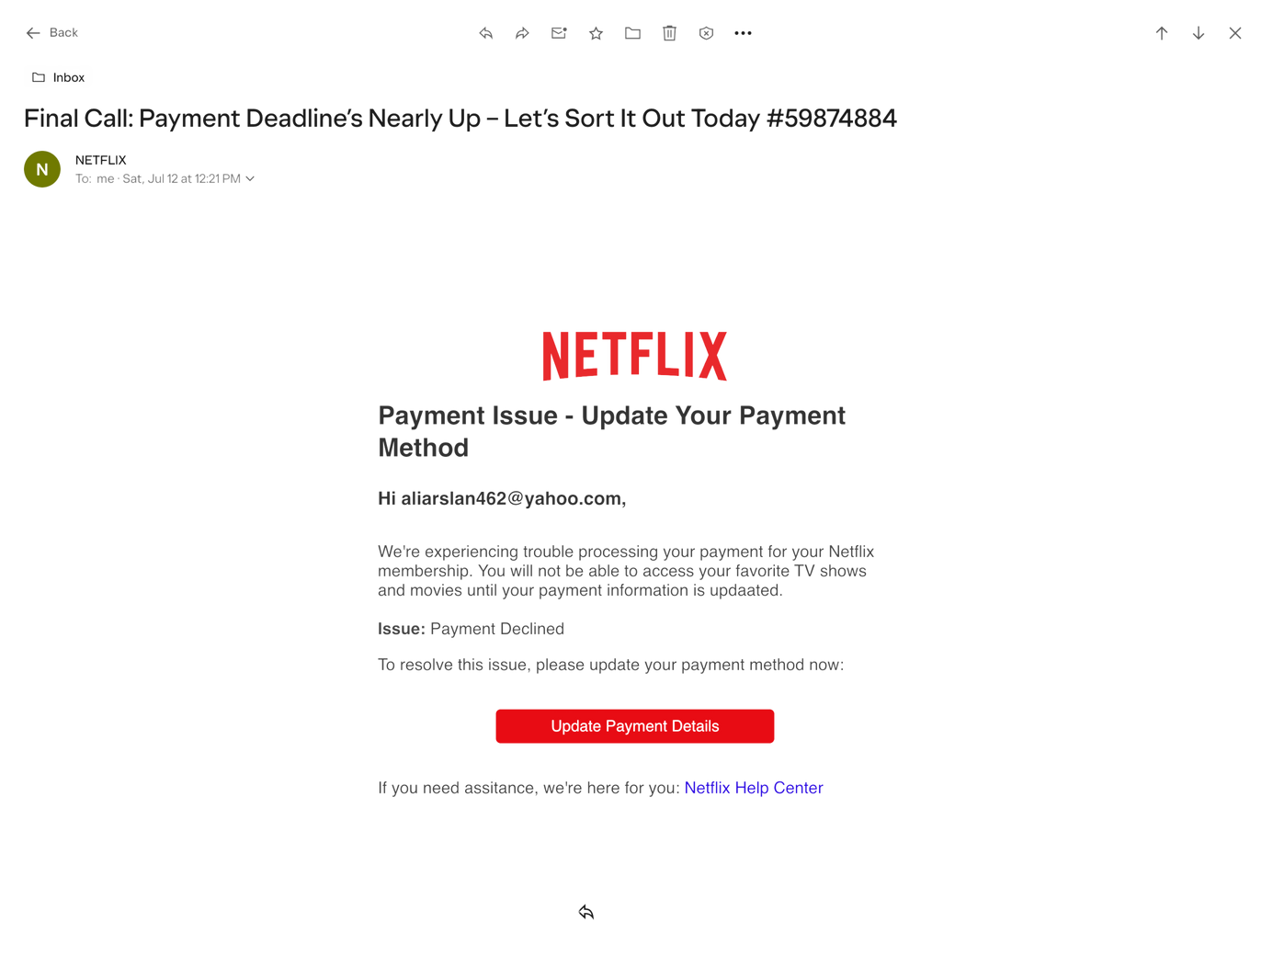
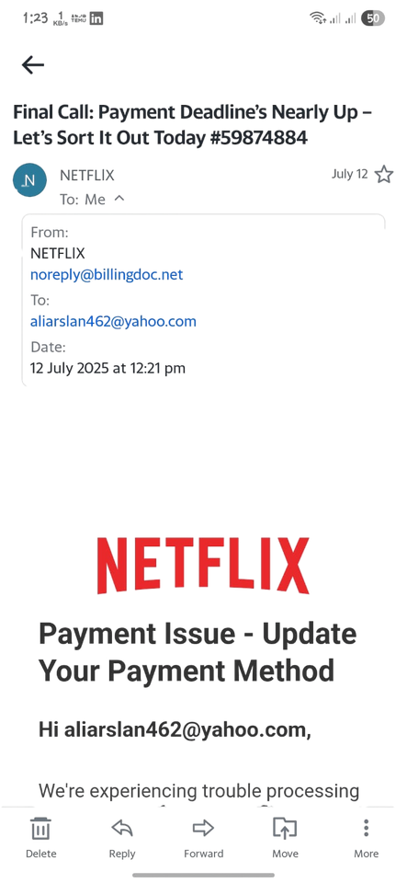
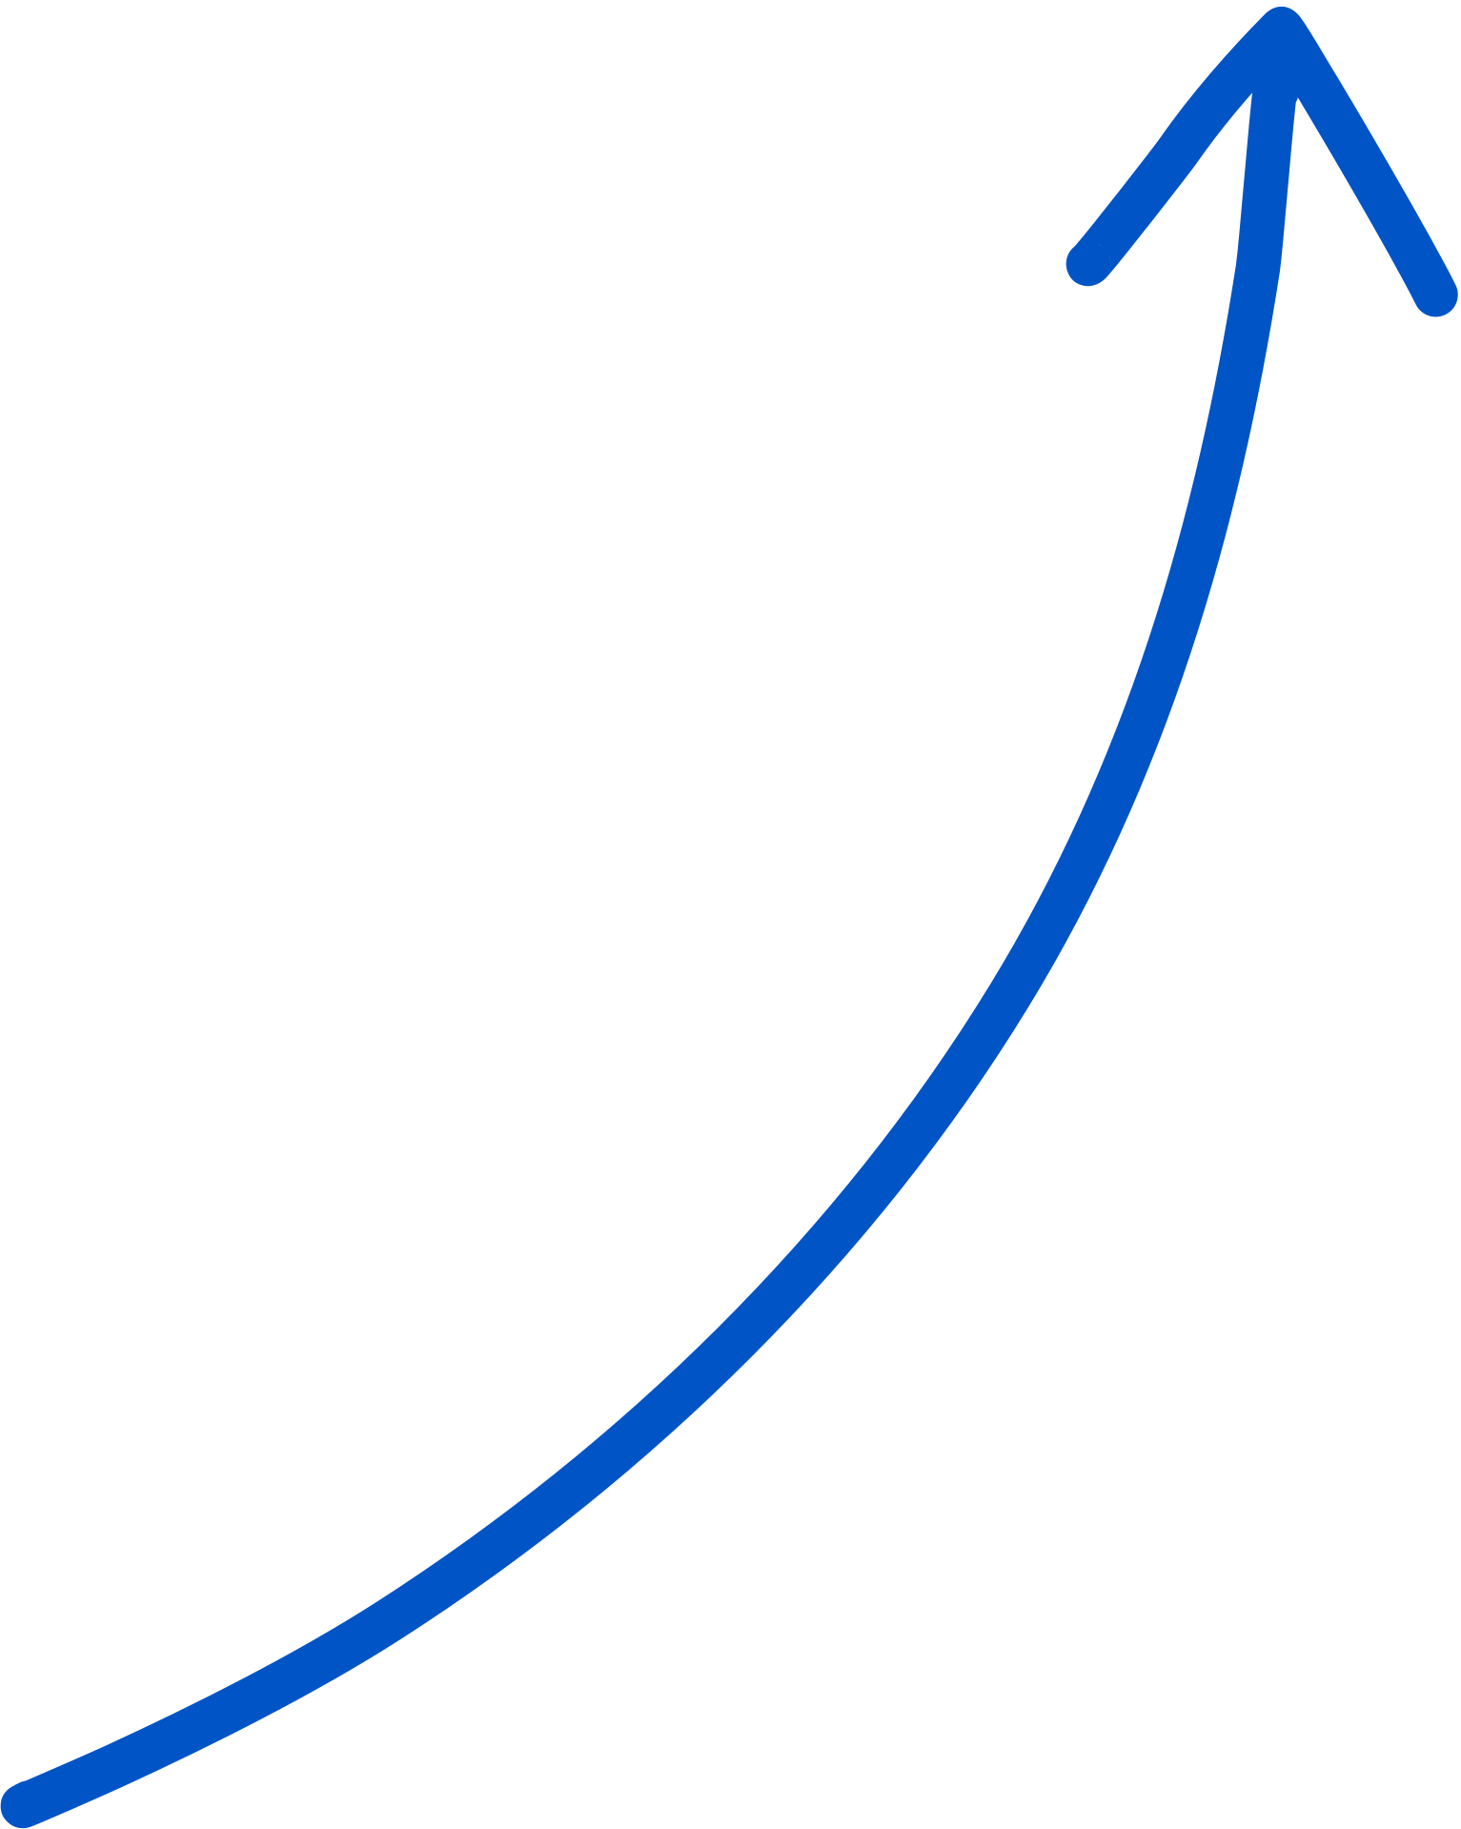
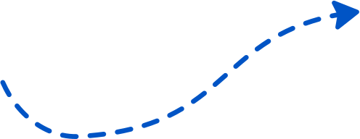
PHISHING AWARENESS
AUGUST 2025
Anatomy of a Phishing Email
Urgent Language
“Final Call,” “Deadline,” “Payment Declined” – creates panic to trigger a quick click
Typos
“updaated,” “assitance” – legitimate companies rarely send emails with spelling errors
Sender Domain
Not @netflix.com — likely a lookalike or random domain
No Name
Suspicious Button
Uses your email address instead of your real name — phishing emails often don’t know who you are
“Update Payment Details” likely leads to a fake payment page to steal your card info
Always check the sender’s email, look for your name, and never click links from unknown sources

Slide 6
PHISHING AWARENESS
AUGUST 2025
The Deceptive Web
Hackers create identical-looking fake websites to steal your login credentials.
Check Before You Click:
Is the URL secure? (🔒 HTTPS)
Does the domain look off? (bank-login-alert.com)
Is the design sloppy or inconsistent?
🧠 Always open websites manually — don’t trust links.

Slide 7
PHISHING AWARENESS
AUGUS 2025
The Psychology Behind the Attack
Social Engineering Tactics:
Fear: “Your account is suspended”
Urgency: “You must verify in 5 minutes”
Authority: “I’m your manager — send me the file”
Curiosity: “Check your invoice”
Greed: “You’ve won an iPhone!”
Hackers don’t hack computers. They hack humans.

Slide 8
PHISHING AWARENESS
AUGUS 2025
Real Attack – Twitter Breach (2020)
Hackers used spear phishing to access Twitter’s admin tools
Took over accounts of Apple, Elon Musk, Barack Obama
Posted fake Bitcoin scams
Result: Millions in fraud + global panic
Lesson:
A single employee’s mistake can bring down the world’s top tech platform.
Hackers don’t hack computers. They hack humans.

Slide 9
PHISHING AWARENESS
AUGUS 2025
Quiz Time – Can You Spot the Phish?
❓ Question:
You receive an email from “support@netfl1x-billing.com” asking you to update your payment info. It says your subscription is suspended. What do you do?
OPTIONS:
🅐 Click the link and update it right away
🅑 Ignore it — it’s probably spam
🅒 Hover over the link, check the sender’s domain, and verify on the official website
🅓 Forward the email to your friends as a warning
✅ Correct Answer: C
WHY? ALWAYS VERIFY SUSPICIOUS EMAILS BY CHECKING THE SENDER’S DOMAIN AND NEVER CLICK ON UNEXPECTED LINKS. USE OFFICIAL CHANNELS INSTEAD.
Well done! Stay alert — phishing can fool even the smartest users.

Slide 10
PHISHING AWARENESS
AUGUS 2025
Stay Alert, Stay Secure
🔐 Think before you click
🕵️ Verify before you trust
⚙️ Update before you delay
📣 Speak up if you see something suspicious
🧠 Cybersecurity is everyone’s responsibility.

Slide 11
PHISHING AWARENESS
AUGUS 2025
Tools & Resources
🔗 Google Phishing Quiz
🔗 Have I Been Pwned?
🔗 StaySafeOnline.org
🔗 NCSC Phishing Guidance
🧠 Cybersecurity is everyone’s responsibility.

Slide 12
PHISHING AWARENESS
AUGUS 2025
Final Words
🛡️ Spread awareness.
🧠 Don’t be the weakest link.
📧 Stay skeptical, stay safe.
Thank you for learning how to stay phishing-smart.
Presented by: Arslan Ali
Phishing awareness

